Slide 1
States Project
10/13/23

Slide 2
What will be covered:
Introduction
Previous works
Open questions
Our data
Our model
Interpreting the model
Next steps

Slide 3

State Space Models
Introduction
Previous works
Open questions
Our data
Our model
Interpretation
Next steps
Statistical models that describe the relationship between hidden state variables and observed measurements over time.
Hidden Markov models (HMMs) are a special type of state-space model where the state are discrete and the observations are generated from a conditional probability distribution given the current state.
This method assumes that hidden states are not directly observable but can only be inferred from observed emissions or measurements

Slide 4
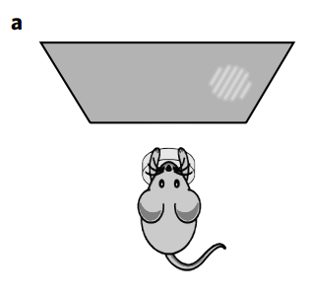
Introduction
Previous works
Open questions
Our data
Our model
Interpretation
Next steps
Context:
It has been observed that mice often ‘lapse’ during behavioral experiments.
Previous explanations: inattention, motor error, incomplete knowledge of the task etc. (assumes lapses arise independently)
Ashwood shows: lapse do not arise independently but, rather, depend heavily on latent states that underlie decision-making behavior
2AFC task
‘lapses’: in which an observer makes an error despite the availability of strong sensory evidence
Ashwood et al

Slide 5
Introduction
Previous works
Open questions
Our data
Our model
Interpretation
Next steps
= dependent
COVARIATES/Influences
To what degree?
Hidden States
OBSERVATIONS
What are the things that could influence the mice behavior?
Stimulus
Bias
Previous Choice
Win-stay Loose-switch
Ashwood et al

Slide 6
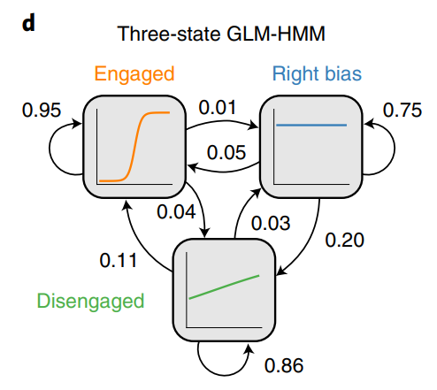
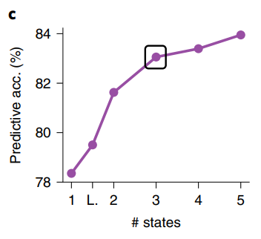
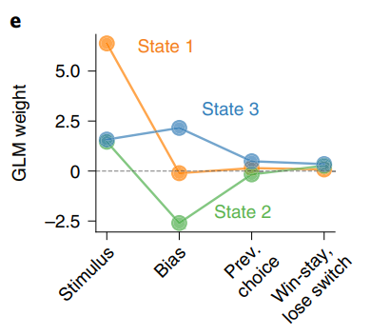
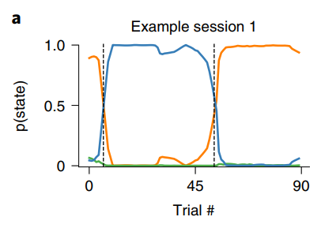
Introduction
Previous works
Open questions
Our data
Our model
Interpretation
Next steps
GLM-HMMs
Ashwood et al

Slide 7
Introduction
Previous works
Open questions
Our data
Our model
Interpretation
Next steps
Real world is “richer”
2AFC task is discrete and binary
We need models that can handle
continuous
multiclass
observations to capture “richer” behaviors

Slide 8
Introduction
Previous works
Open questions
Our data
Our model
Interpretation
Next steps
The following Dataset and Experimental Setup is kept simple to focus on the model instead

Slide 9
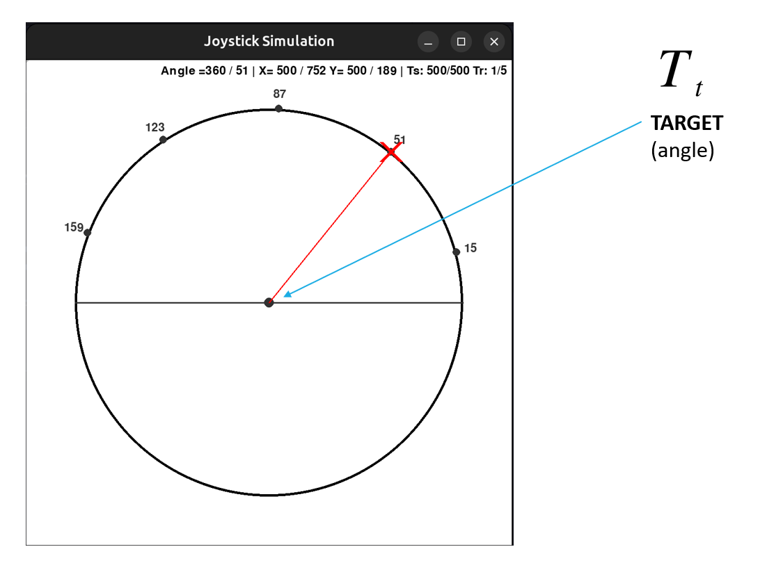
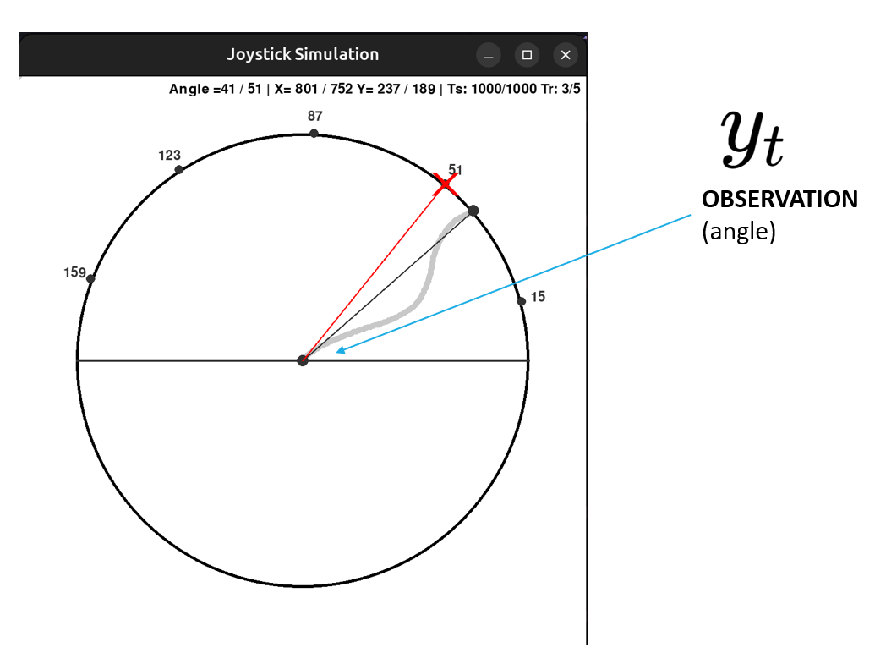
Introduction
Previous works
Open questions
Our data
Our model
Interpretation
Next steps

Slide 10
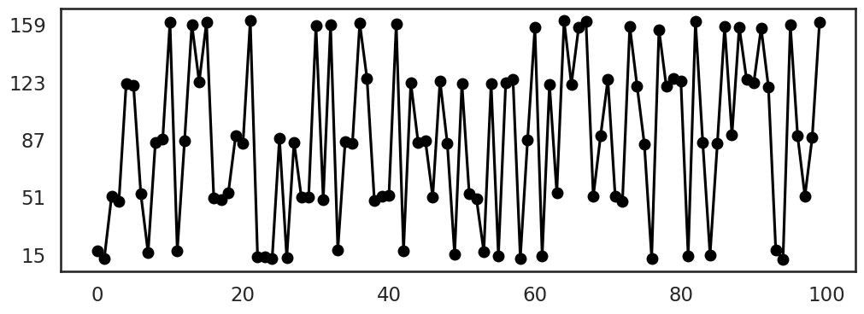
Angles
Two synthetic strategies applied:
For the first 90, I answered according to the TARGET_{t}
For the last 10, I answered according to TARGET_{t-1}

Slide 11
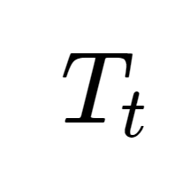
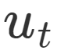
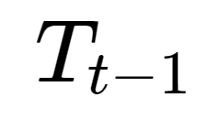
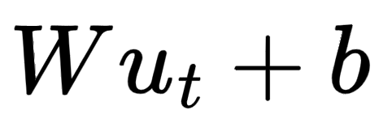
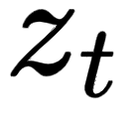
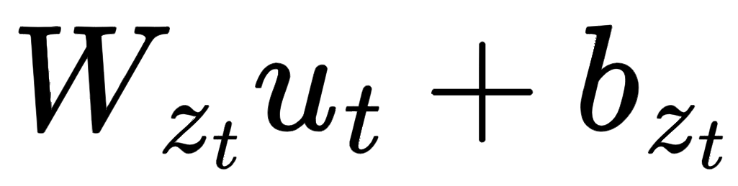

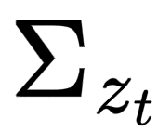
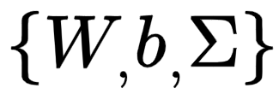
What are the external independent covariate that could have influenced my decision making (a.k.a. OBSERVATION angle)?
TARGET_{t}
TARGET_{t-1}
=
=
Vector of covariates
We will be modeling it in a multivariate normal distribution
Linear regression with covariates (for mean):
However, weights and biases change for every state
Therefore, with state dependent weights and biases:
Similarly for the covariance:
Are learnt parameters

Slide 13
Angles
Two synthetic strategies applied:
For the first 90, I answered according to the TARGET_{t}
For the last 10, I answered according to TARGET_{t-1}

Slide 14
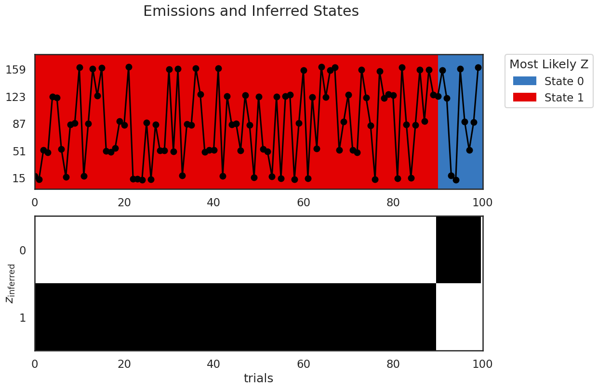
Angles

Slide 15
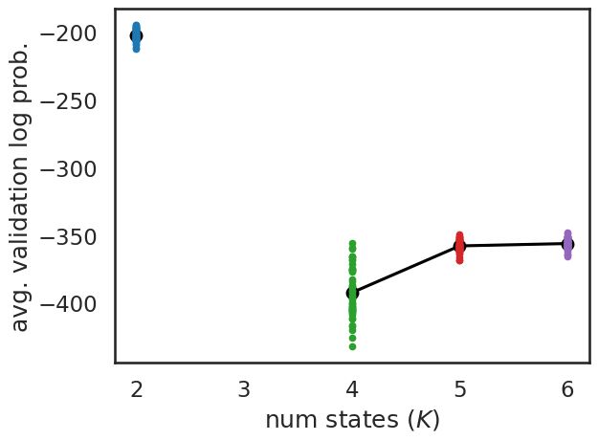

Slide 16
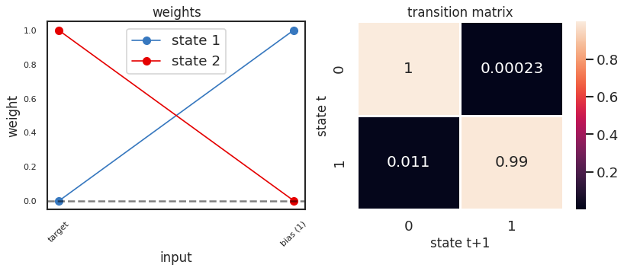
Target_{t}
Target_{t-1}
However, our model is not just weights. It’s a normal distribution with weights + bias for mean, covs

Slide 17
Comparable to:
Target_{t}
Target_{t-1}

Slide 18
Recovered parameters:
For state 1:
5.38e-05
1.00
-0.031
-0.031
2.84
0
0
2.84
For state 2:
0.99
8.35e-04
-0.031
-0.0039
3.03
0
0
3.03

Slide 19
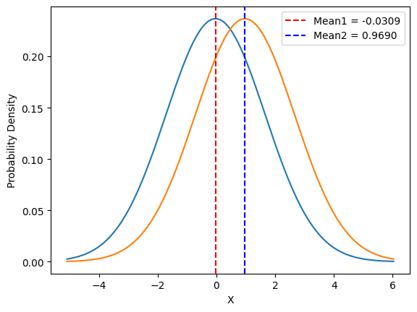
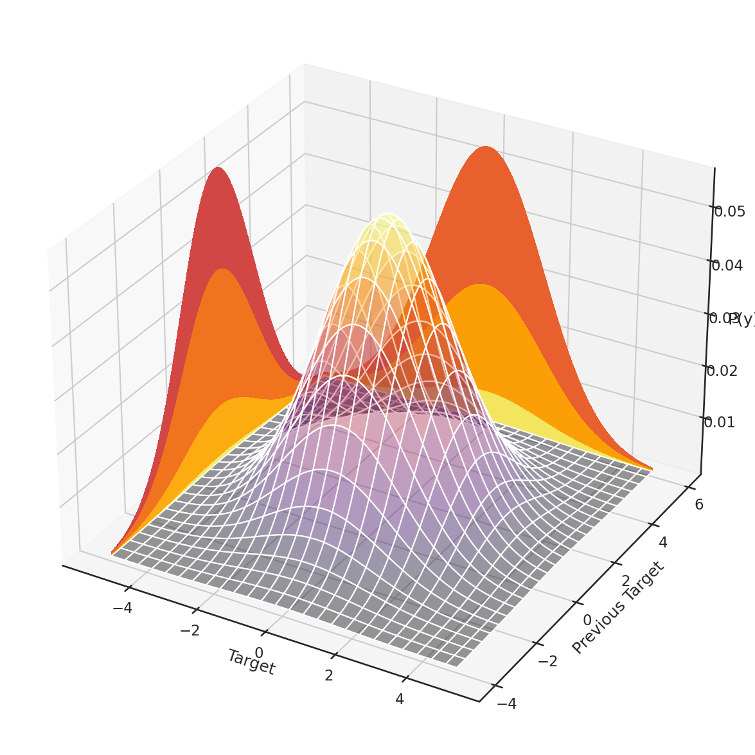
For state 1:
5.38e-05
1.00
-0.031
-0.031
2.84
0
0
2.84
STATE 1

Slide 20
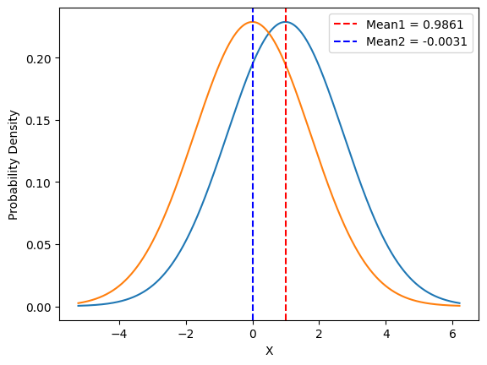
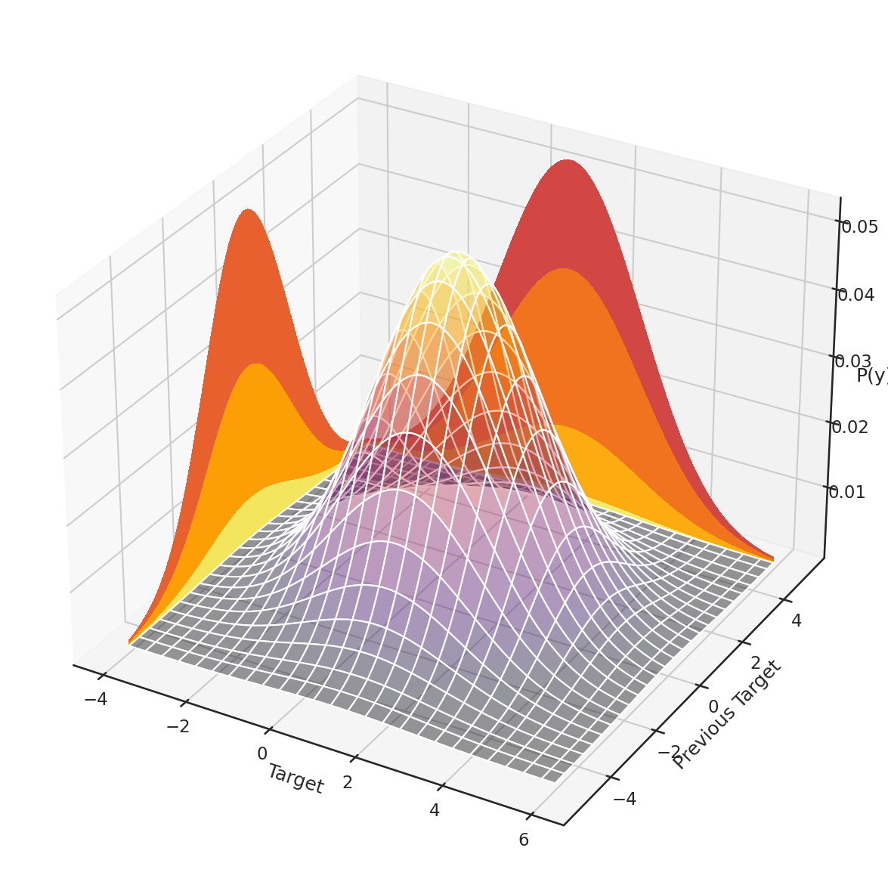
For state 2:
0.99
8.35e-04
-0.031
-0.0039
3.03
0
0
3.03
STATE 2

Slide 21
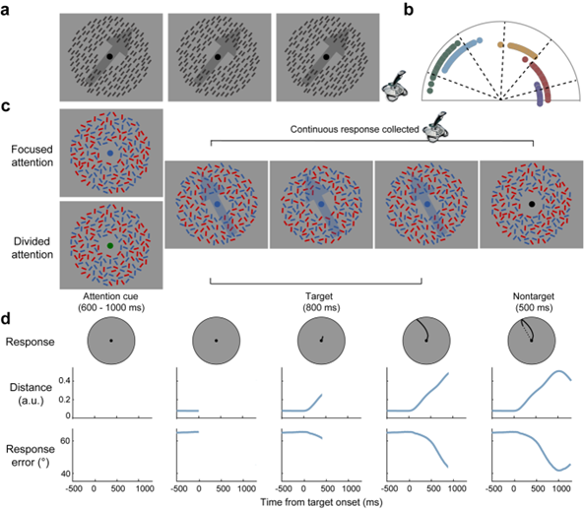

Slide 22
Now that we have the predicted states, we can try to find the corresponding EEG and VALIDATE the predicted states through RSA/decoding of the EEG etc.
Show how the states change as a function of different
- Attention
- Top-Down factors
- Selective attentions
- Prior expectation
- Bottom-Up factor
- Coherence of dots is high or low

Slide 23
Thank you! ☺

